Slide 1
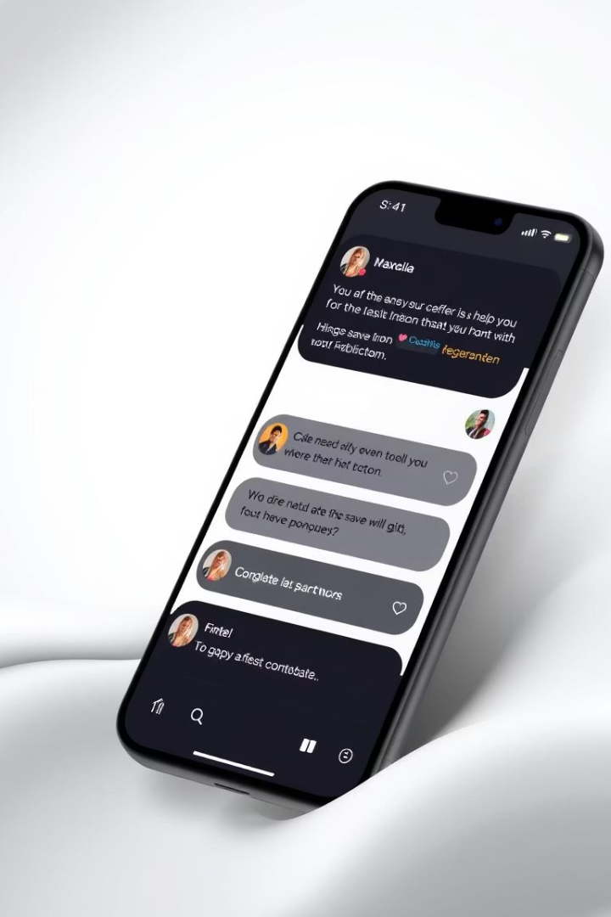
Real-Time Chat Application
Built with Node.js, Socket.io, Express & MongoDB

Slide 2

Introduction
This presentation outlines the development of a real-time chat application.
The goal is to enable live communication between two users.
This project increases hands-on knowledge in full-stack web development.
Purpose
Goal
Motivation
Real-time chat application
Live communication
Enhance web development skills

Slide 3

Tools & Technologies Used
A variety of technologies were used.
HTML, CSS, and JavaScript were used for the frontend.
Node.js and Express.js powered the backend.
Frontend
Backend
HTML
Node.js
CSS
Express.js
JavaScript
Real-Time
Database
Socket.io
MongoDB

Slide 4
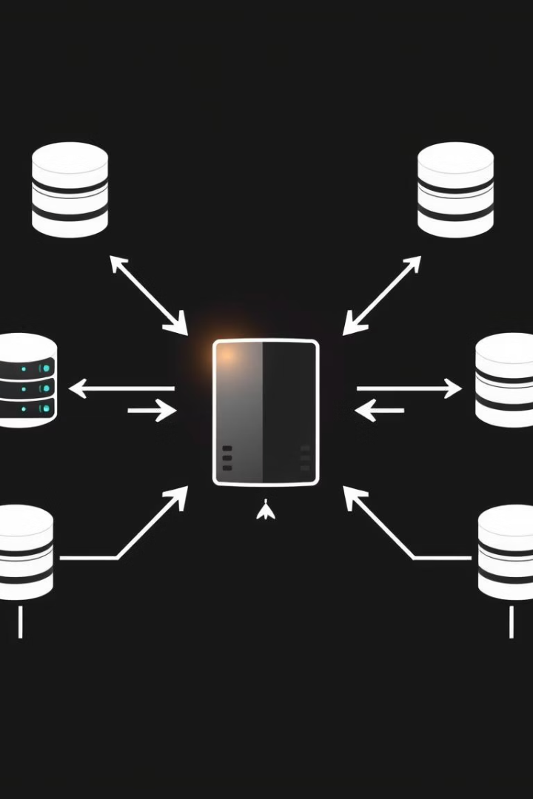




Backend Architecture
The backend uses a Node.js server with Express.js.
Socket.io enables real-time communication.
RESTful API endpoints handle user authentication.
Node.js Server
Socket.io
RESTful API
Modular Design

Slide 5




Frontend Implementation
HTML structures the user interface.
CSS provides styling and layout.
JavaScript handles user interactions and real-time updates.
HTML
Structure
CSS
Styling
JavaScript
Interaction

Slide 6

Database Design
MongoDB, a NoSQL database, was used.
The user schema includes username, password, and email.
Chat schema includes sender, receiver, message, and timestamp.
User Schema
Username, password, email
1
2
Chat Schema
Sender, receiver, message

Slide 7



Key Features
The application supports real-time messaging.
It also has secure user authentication.
Users can see who is online and typing.
1
Real-time messaging
2
User Authentication
3
Online status

Slide 8
Setup and Installation
First, clone the GitHub repository.
Then, install dependencies using npm install.
Start the server using npm start.
1
Clone Repo
2
npm install
3
npm start

Slide 9




Demo
A live demonstration of the chat application will now be shown.
We'll showcase real-time messaging.
The responsive design will be highlighted.
Live Demo
1
Real-Time Messaging
2
4
Responsive Design
3
User Authentication

Slide 10
Challenges & Conclusion
Challenges included scaling and data consistency.
The application was successfully developed.
Future enhancements include group chat and file sharing.
Challenges
Future Enhancements
Scaling
Group chat
Data consistency
File sharing
Security
Message encryption

